Slide 1

LOGSENTINEL AI
Multi-Agent SOC Analyst for Critical Infrastructure
Track 4: AI Log Analyzer Agent

Slide 2


The Challenge: OT Under Siege
Operational Technology (OT) systems are increasingly targeted, with ransomware attacks surging 87% last year.
Manual log analysis is too slow for critical threats.
Security teams lack specialized OT context.
LogSentinel AI bridges this gap with an automated, multi-agent approach.

Slide 3












System Architecture
Frontend
Backend
Data & Vector
ML Pipeline
React dashboard with Tailwind CSS for file upload, search, and Copilot chat interface.
FastAPI serving 5 core endpoints (Upload, Search, Anomalies, Logs, Chat).
SQLite for metadata and for local semantic search over log embeddings.
Sentence-transformers for embeddings and for anomaly detection.

Slide 4

Multi-Agent Core
Powered by and Claude 3.5 Sonnet.
Orchestrator: Routes queries & synthesizes results.
Log Analyst: Semantic search & timeline analysis.
Anomaly Hunter: Pattern detection & severity.
Threat Mapper: Correlation to MITRE ATT&CK.

Slide 5
Engineering Trade-offs
Component | Choice | Alternative | Reasoning
Database | SQLite | PostgreSQL | Simplifies deployment for MVP; sufficient scale.
Vector Store | FAISS | Pinecone | Runs locally with no external dependencies.
Orchestration | LangGraph | Raw LLM Calls | Superior multi-agent state management.
Embeddings | Sentence-Transf. | OpenAI API | Free, fast, local inference for high volume logs.

Slide 6
MVP Scope: What's Included
Smart Ingestion: Log upload with auto-format detection.
Deep Search: Semantic search over indexed log content.
ML Analytics: Anomaly detection with severity scoring.
Attack Tracing: Multi-agent copilot traces full kill chain.
Contextualize: MITRE ATT&CK mapping (Enterprise & ICS).
Out of Scope: Real-time streaming & multi-file correlation.

Slide 7

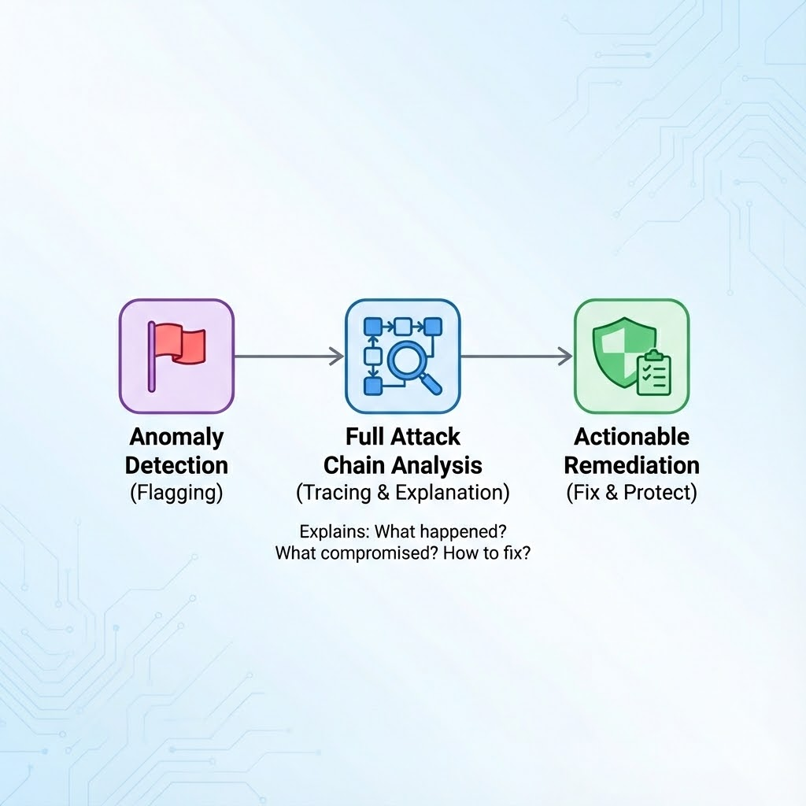
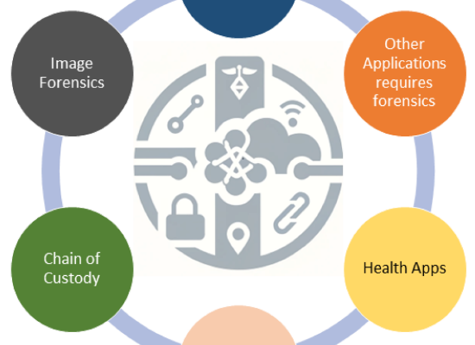
The LogSentinel Advantage
Beyond Simple Detection
Most tools just flag anomalies.
LogSentinel AI traces the full attack chain, explains exactly what happened, what was compromised, and provides actionable remediation steps.

Slide 8


LogSentinel AI
Let's Build It.
https://github.com/markustips/hackathon-logsentinel
markleo@outlook.com

Slide 9



Image Sources
https://media.istockphoto.com/id/1499410369/photo/warning-icon-on-a-digital-lcd-display-with-reflection.jpg?s=612x612&w=0&k=20&c=igwX3tcYUCAg4gN0CxdxavGCnKeTBmtbGkuk-yyz6s4=
Source: www.istockphoto.com
https://smythos.com/wp-content/uploads/2025/02/neuronal_network_visualization.jpeg
Source: smythos.com
https://pub.mdpi-res.com/information/information-15-00109/article_deploy/html/images/information-15-00109-g001.png?1708303270
Source: www.mdpi.com

